Slide 1
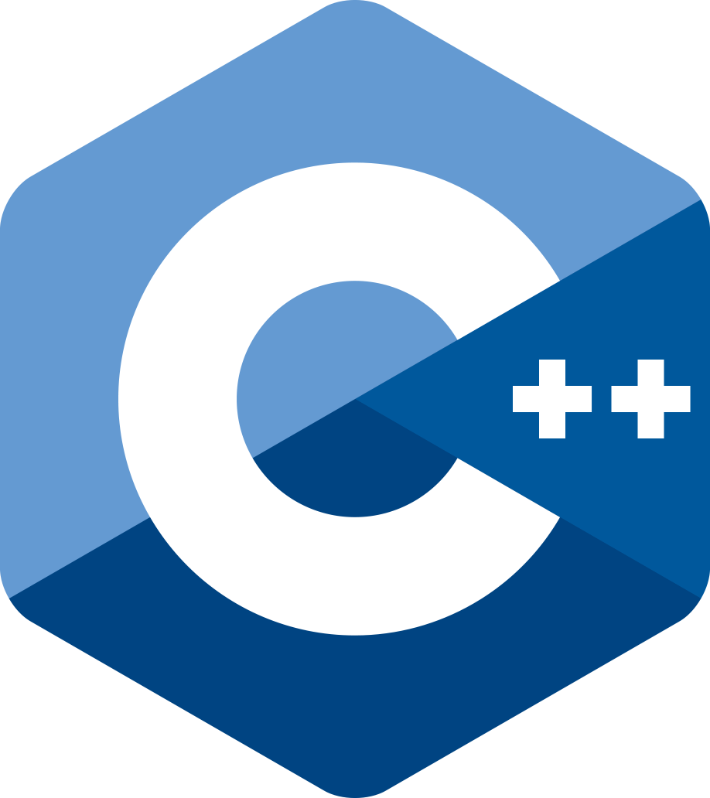
C++ Language
Swapnajit Patil

Slide 2
History & Basics
Object-oriented language invented at AT&T Bell Labs by Bjarne Stroustrup in 1980.
Successor of C, had an effect of Simula67.
Called as ‘C with classes’. It’s a superset of C.
Has OOP based advantages over C like inheritace, polymorphism, encapsulation, classes and objects, etc.
POP vs OOP (Advantages, Structure, etc).
Basic OOP Concepts (Classes, Objects, Inheritance, Polymorphism, Message Passing, Dynamic Binding, Encapsulation, etc)
Benefits of OOP
Object Oriented and Object Based Languages.
Applications of OOP

Slide 3
Basics
Basic structure of C++ Program (include files, classes definition, member functions declaration, main() function).
Basic components of C++ Program (main() function, comments, file inclusion preprocessor directives, namespace, variable declaration, input statement, output statement).
Basic C++ header files (stdio.h, stdlib.h, iostream.h, string.h, iomanip.h, fstream.h, float.h, asssert.h, time.h, limits.h, etc).
ANSI C++ header files (vector, list, stack, queue, dequeue, set, map, iterator, algorithm, exception, functional, memory, string, locale, limits, etc).
C++ program execution.

Slide 4
Tokens, Data Types, Operators, Expressions
C++ keywords (48) most of them are common to C & added by ANSI C++ (16).
Identifiers and Constants declaration rules.
Data types in C++
Built-in types (Integral (int, char), Floating point (float, double), void).
User-defined types (structure, union, enumeration, class).
Derived types (array, function, pointer, reference).
Storage classes (auto, static, extern, register).
Symbolic constants (const, enum).
Variable declaration & initialization.
Reference variables (aliases).
Operators (basic, scope resolution, member dereferencing (::*, ->*, .*), memory management operators (new, delete)).
Manipulators (endl, setw()).
Type casting [type(), (type)] & Implicit conversions.
Expressions (constant, integral, float, pointer, relational, logical, bitwise, assignment).
Control structures and Loops.

Slide 5
Functions in C++
Main() function.
Function prototyping, function definition.
Call by reference, call by value.
Return by reference.
Inline function.
Default arguments and its rules.
Const arguments.
Recursion.
Function overloading.
Friend and virtual functions.
Math library functions (sin(), cos(), asin(), pow(), log(), etc).

Slide 6
Classes and Objects
Specifying a class (variable declarations, function definitions).
Defining member functions (inside class, outside class), member functions nesting, private member function.
Creating objects, accessing class members (variables, functions).
Array within class, array of objects.
Memory allocation for objects.
Static members (variables, functions).
Object as argument to function, returning object.
Friend function.
Local classes.

Slide 7
Constructors, Destructors & Operator Overloading
Constructor, rules to define constructor and its types (default, parameterized, copy).
Multiple constructors in a class (overloaded constructors).
Constructor with default arguments.
Dynamic initialization of objects.
Destructors
Operator overloading, operator overloading rules.
Overloading unary operators, overloading binary operators (with/without friend function).
Type conversion.

Slide 8
Inheritance, Virtual Functions & Polymorphism
Inheritance and reusability.
Base class, derived class and defining derived class.
Inheriting members (Private, Public), Protected access.
Inheritance types (Single, Multilevel, Multiple, Hierarchical, Hybrid).
Virtual Base class, Abstract class.
Constructors in derived class.
Member classes (Nesting of classes).
Pointers in C++, manipulation and operations on pointers.
Pointer to objects, pointer to base and derived class objects, this pointer.
Virtual functions, accessing virtual functions, rules for virtual function.
Pure virtual functions
Virtual constructor and virtual destructor.

Slide 9
Console I/O and File I/O
C++ Streams and stream classes (ios, istream, ostream, iostream, streambuf).
I/O objects (cin, cout)
I/O functions (get(), getline(), put(), write()), Overloaded operators (<<, >>).
Formatted I/O operations (width(), precision(), sef(), unsetf(), setw(), setprecision(), setfill(), setiosflags(), resetiosflags(), endl).
Designing our own manipulator.
File stream classes (fstream, ifstream, ofstream, filebuf, fstreambase).
Opening (with constructor, with open()) and closing files.
Detecting end-of-file (eof(),object itself).
File pointer and their manipulation (seekg(), tellg(), seekp(), tellp()).
File I/O functions (read(), write(), get(), put()), reading/writing class object, random access to files
Error handling during file operations (eof(), fail(), bad(), good()).
Command line arguments.

Slide 10
Templates and STL
Templates and generalization, generic data type.
Class templates (with single and multiple parameters).
Function templates (with single and multiple parameters).
Template function overloading, member function templates, Nontype template arguments.
Components of STL (containers, algorithms, iterators).
Containers and its types (sequence (vector, list, deque), associative (map, set, multimap, multiset), derived (stack, queue, priority-queue)).
Algorithms (mutating, non-mutating, sorting, set, relational, numeric).
Iterators (input, output, forward, bidirectional, random).
Application of container classes and their respective functions (vector, list, stack, queue, priority-queue, set, map).

Slide 11
Exception Handling, String Manipulation & ANSI C++ Additions
Error, exception, exception handling mechanism.
Try, throw, catch, multiple catch blocks, catching all exceptions.
Catching class type as exception, rethrowing exception.
Specifying exceptions (throw()), exceptions in constructor and destructor.
Strings in C++ (creation and manipulation).
String characteristics (size(), capacity(), length(), max-size(), empty()).
Accessing characters in strings (at(), substr(), find(), find-first-of(), find-last-of()).
Comparing and swapping strings (compare(), swap()).
ANSI C++ Additions (data types(bool, wchar-t), explicit and mutable keywords, operator keywords(and, or, not, etc.), new headers).

Slide 12
Interview Asked Questions (Addition to all points covered in previous slides)
Why do we call C++ as OOPS?
Define encapsulation and abstraction.
Explain volatile keyword (with respect to variable and function).
Can we have a recursive inline function in C++? Can compiler ignore inline function.
this pointer.
Explain storage classes in C++ (auto, extern, static, register, mutable).
Explain friend class and friend function.
Compare C and C++.
Compare C++ and Java.
Is it possible for a C++ program to be compiled without the main() function?
Explain virtual functions, pure virtual function and run-time polymorphism.
Compare structures in C++ and class.
Compare structures in C with structures in C++.

Slide 13
Interview Asked Questions
What does static member means?
Explain various access specifiers in C++ (private, public, protected).
Explain constructors with it types and destructor.
Explain concept of reference variable, reference vs pointer.
Explain abstract class.
Explain uses of scope resolution operator.
What is namespace? What is use of keyword ‘using’.
Explain Class template an function template.
Explain inheritance and its various types.
Explain function overloading and function overriding.
Explain new data types added to C++ (bool, wchar_t).
Explain default standard streams (cin, cout, cerr, clog).
Explain command line arguments.

Slide 14
Interview Asked Questions
Can I use malloc() function of C language to allocate dynamic memory in C++?
Can I use ‘delete’ operator to release the memory which was allocated using malloc() function of C language?
What is container class?
Is it legal to assign a base class object to a derived class pointer? And for vice-versa as well.
Comment on virtual constructor and virtual desctructor.
What is the order of objects destroyed in the memory? Reverse.

Slide 15


